Slide 1

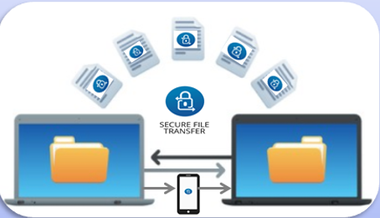

Bayou Classic BizTech Challenge 2017
Team Members:
Gary White
Kerwan Antoine
Jarrid Richards
Lala Aicha Coulibaly
Akane Simpson
Faculty Coach:
Dr. Prasanthi Sreekumari
SecureShare
“A Secure File Sharing Using Two-Factor Authentication for Business”

Slide 2

Introduction
Business processes often require people to work together to share “SENSITIVE” files. This resulted in File Sharing. File Sharing is the practice of or ability to transmit files from one computer to another over a network or the Internet.

Slide 3
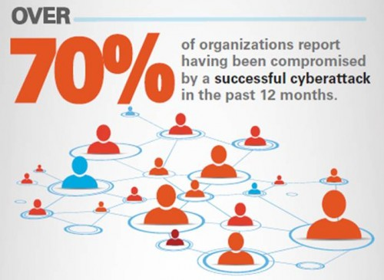
Market Problem
Cyber Security threats in File Sharing
High-profile data breaches of corporate giants make the headlines. But 77% of cyber crime actually targets small and medium-size enterprises (SMEs).

Slide 4
Market Problem
EASIER TARGETS
65% of SMEs have
NO Data Security
Policies.
Attackers bypassed
multiple layers of
security in 96% of
SME deployments in
a real-world study
58% of SME
managers do not
see cyber attacks
as a significant risk
Data breaches cost an
average of $217 per
stolen record, which
adds up quickly.
LOW RISK,
HIGH RETURNS
10% of cyber
crimes reported result
in a conviction.

Slide 5
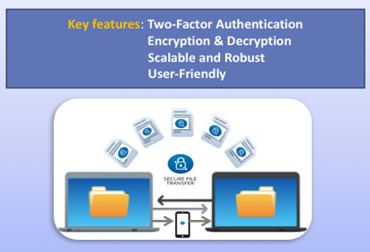
Solution
SecureShare
A Computer Software designed and developed for sharing sensitive files securely using two-factor authentication.
To encrypt and decrypt the confidential files we used the Advanced Encryption Standard Algorithm(AES-256 Bits).

Slide 6
Start
Login Successful
Enter Predetermined User ID and Password
File Interface
User Validation (1st level Authentication)
YES
ON
Send Password via Text Message and Email Confirmation to Receiver
Select File – Select User to Share – Encrypt File
Login Unsuccessful
File Shared to User
Display Error Message

Slide 7

Target Market
Small-Medium Sized Enterprises
“Sensitive” Data
Health Care, Financial, Security Industries
Workforce of -200-500 employees

Slide 8
Marketing Strategy/Distribution Channels
Direct Channels
Company Website
Sponsorships (Cyber Crime Seminars)
Indirect Channels
Social Media (LinkedIn, FB, Youtube)
Google Ads
Billboards
Mass Email Marketing
Distribution Channels
Sales Representatives
Network Integrators & ISV’s
Internet

Slide 9

Competitors
Platform | Encryption/Decryption AE S(Bit) | ERP | Password Protection | Two-Factor Authentication | Recipient Identity Verification | Support
BOX | 256 | CLOUD |  | LIMITED TO LOGIN
OPENDRIVE | 256 | CLOUD
DROPBOX | 256 | CLOUD |  | NEED TO BE ENABLED
GOOGLE DRIVE | 128 | CLOUD |  | NEED TO BE ENABLED
SUGARSYNC | 256 | CLOUD |  | NEED TO BE ENABLED
ONE DRIVE | 256 | CLOUD |  | NEED TO BE ENABLED
SECURESHARE | 256 | ON-PREMISE

Slide 10

Revenue Streams
Revenue will be generated from:
Ads from free trial version
Add-on features
$$$
Tier Packages
Tiers | Users | File Editor | File Converter | Simultaneous Use of Files | Mobile Application
Tier 1 – Ultra | 0-250 | YES | NO | NO | LIMITED ACCESS
Tier 2 – Master | 250-500 | YES | YES | YES | YES

Slide 11
Customer Feedback

Slide 12
Current Status and Future Work
THEN
Mobile App (Out of Band)
Simultaneous Use of Files
File Converter
NOW
Notifications in Interface
Message Board
File Access Notifications

Slide 13
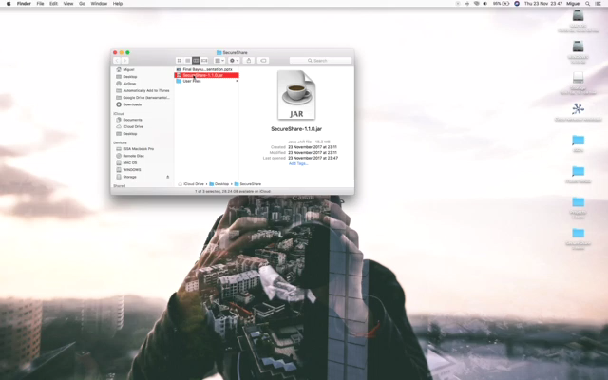
SecureShare Demonstration

Slide 14
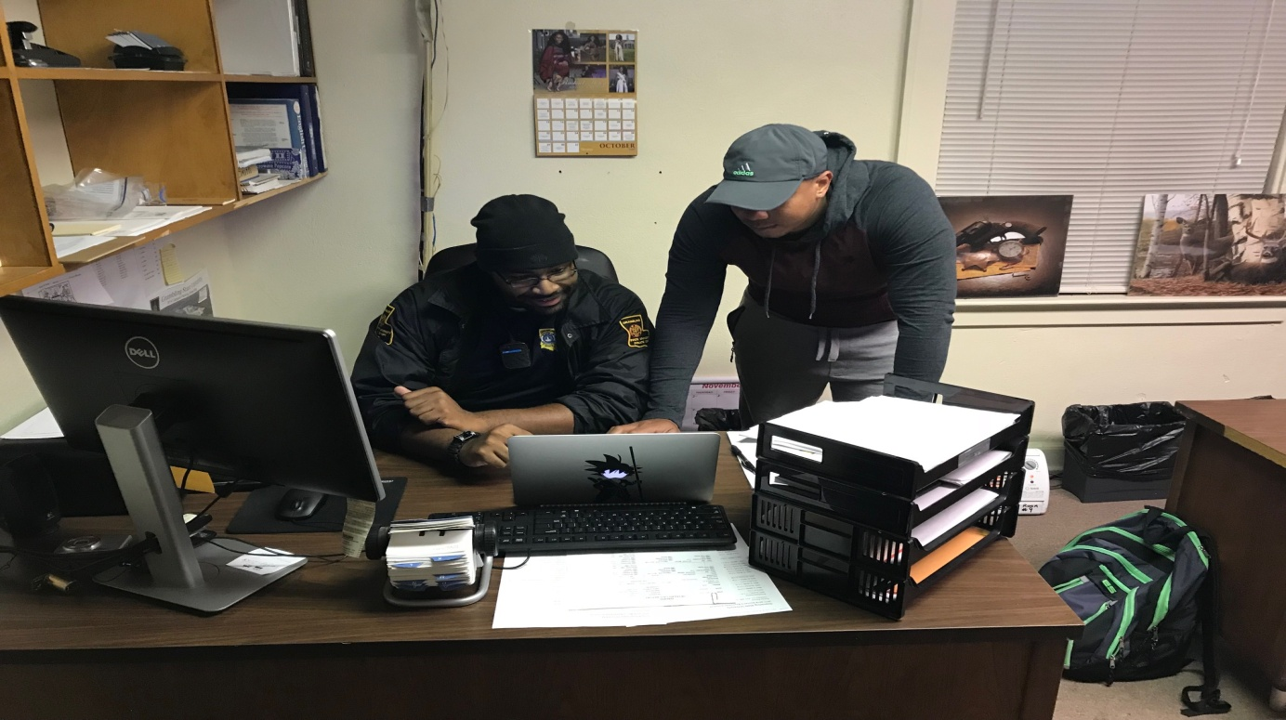
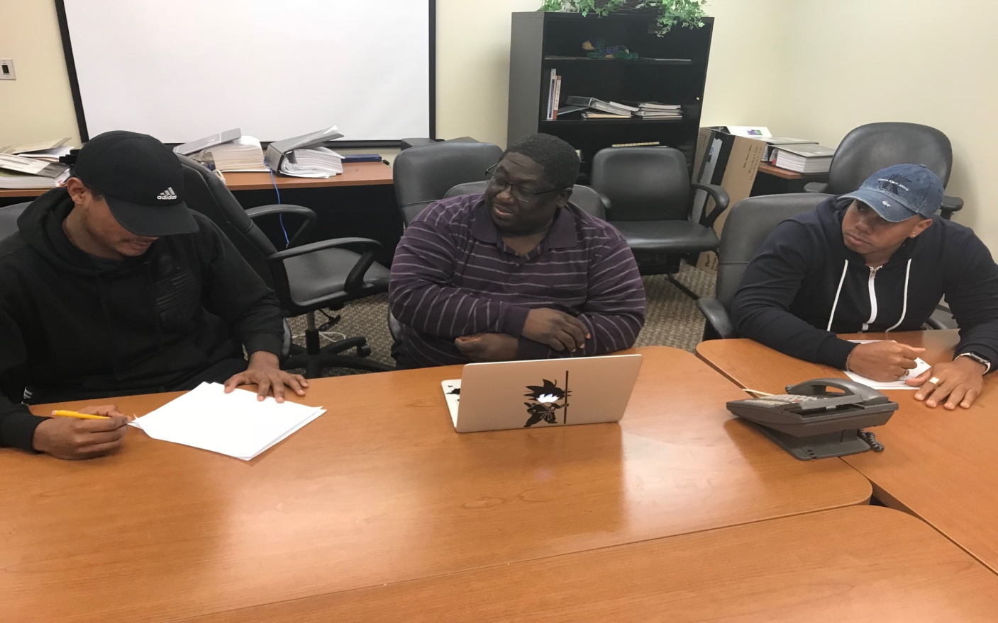
Questions?

